Slide 1
FCNM
By
Arun

Slide 2
Core
Aggregation (distribution)
Access
Leaf
Spine
Tree
Fat Tree

Slide 3
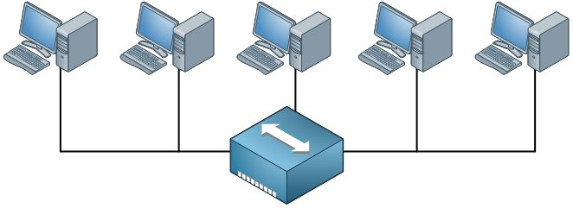

Slide 4
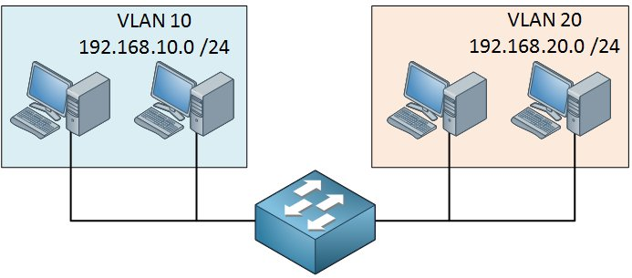

Slide 5
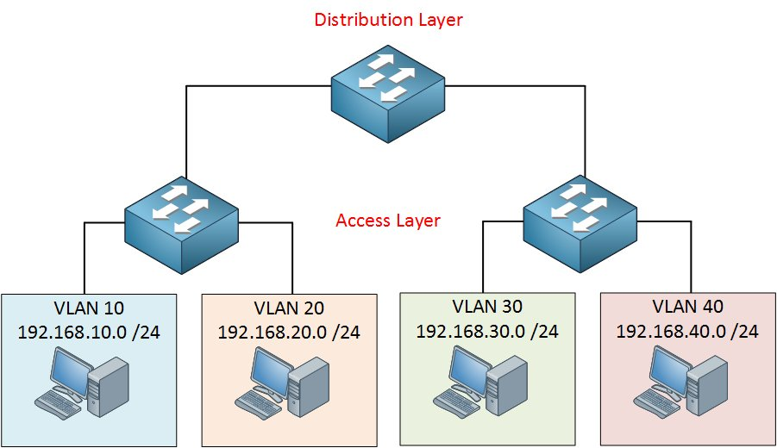

Slide 7
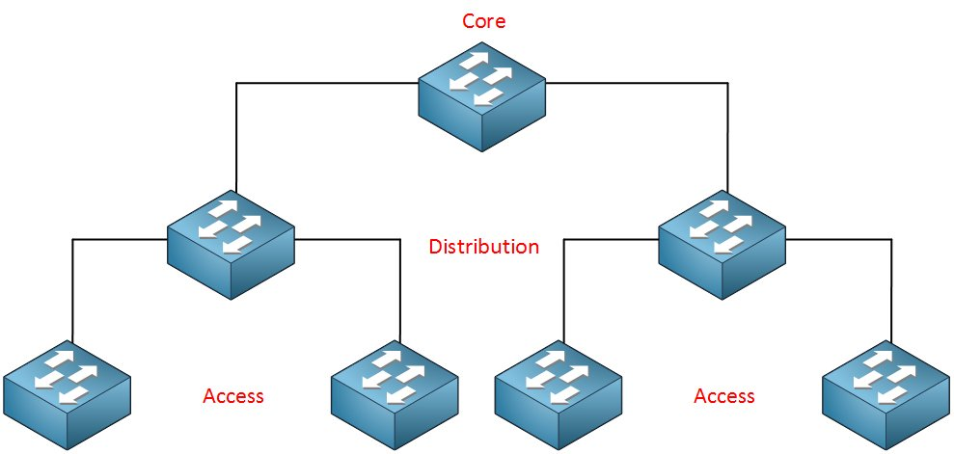

Slide 8
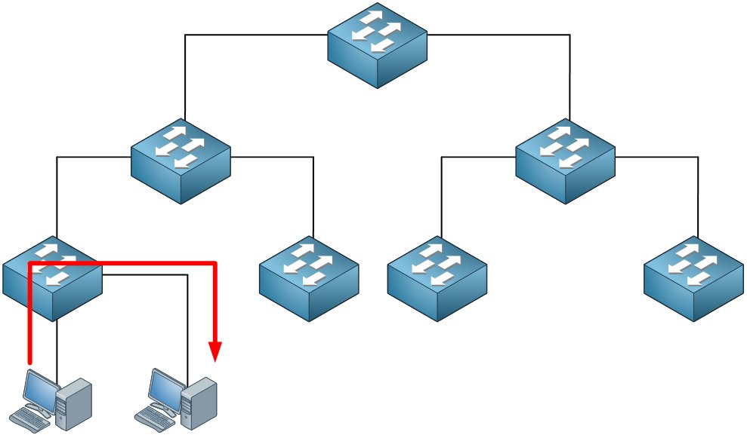

Slide 9
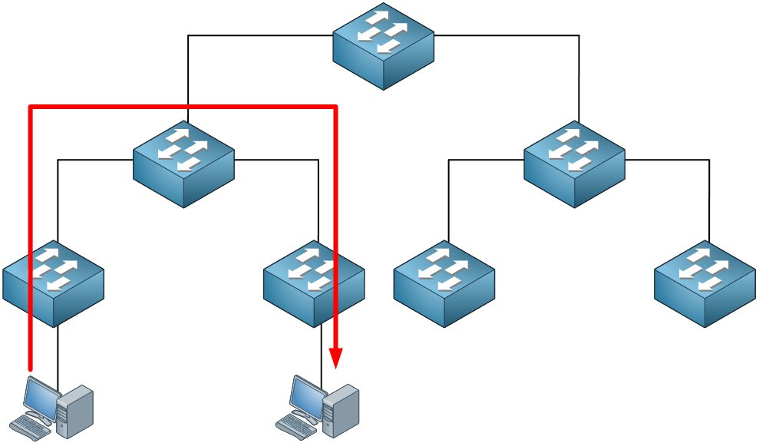

Slide 10
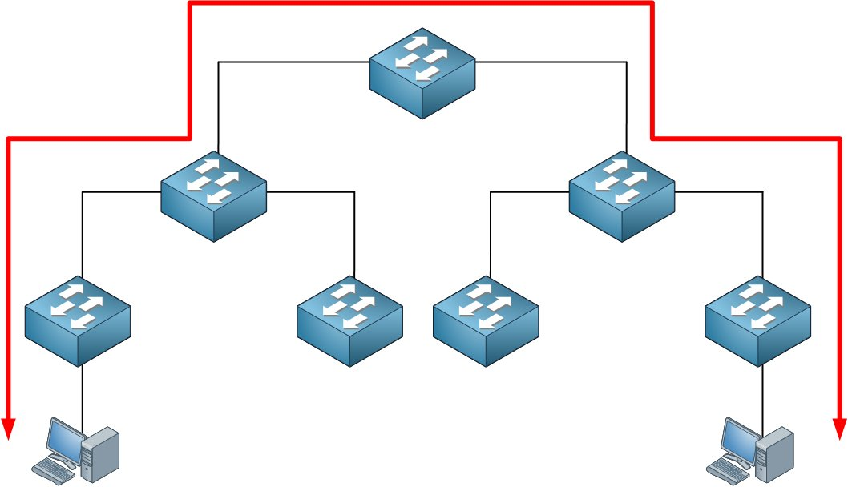

Slide 11
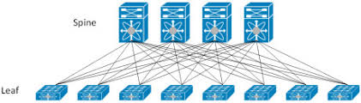

Slide 12
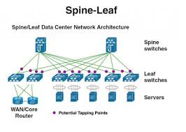

Slide 13
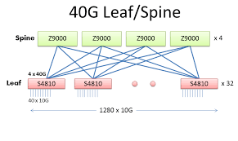

Slide 14
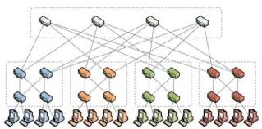

Slide 15
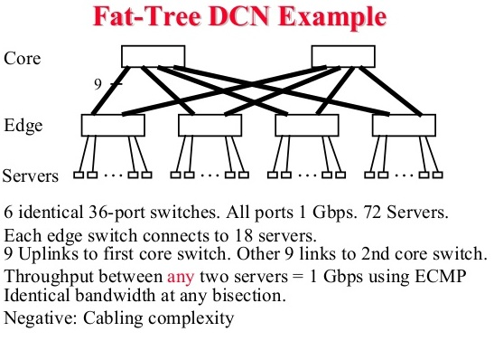

Slide 16
Ingress
Egress
Input Buffer
Output Buffer
Blocking
Head of Line Blocking (HOL – B)
Virtual Output Queuing (VOQ)

Slide 17
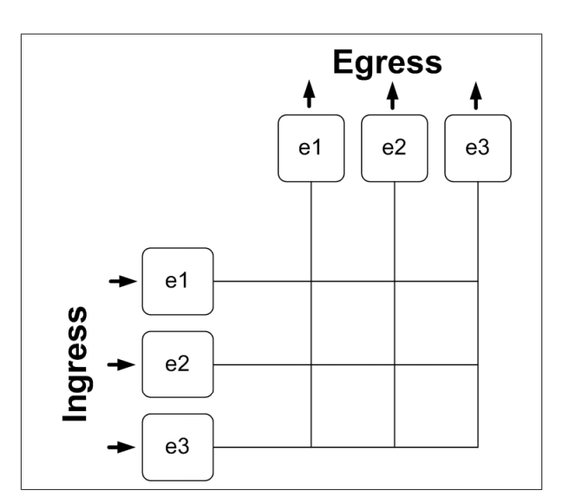

Slide 18
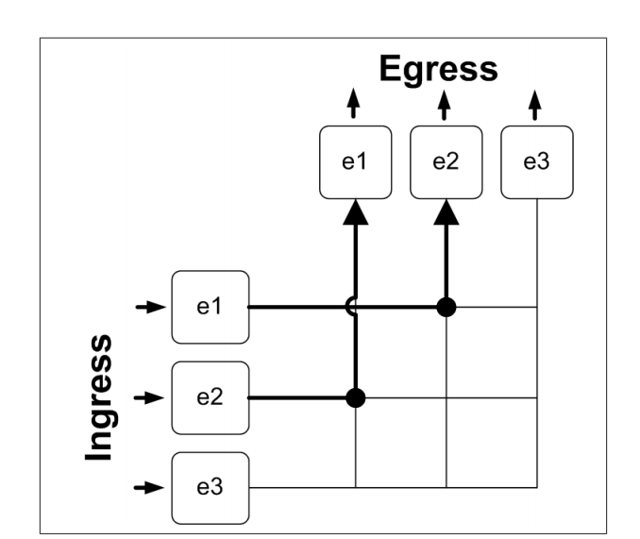

Slide 19
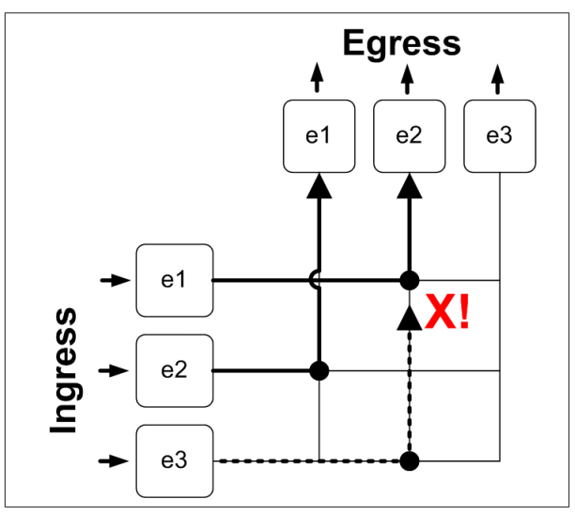

Slide 20
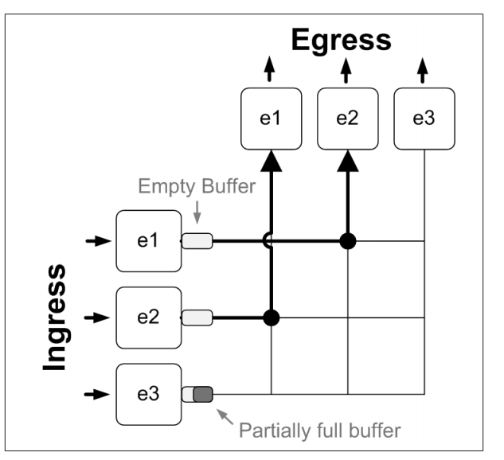

Slide 21
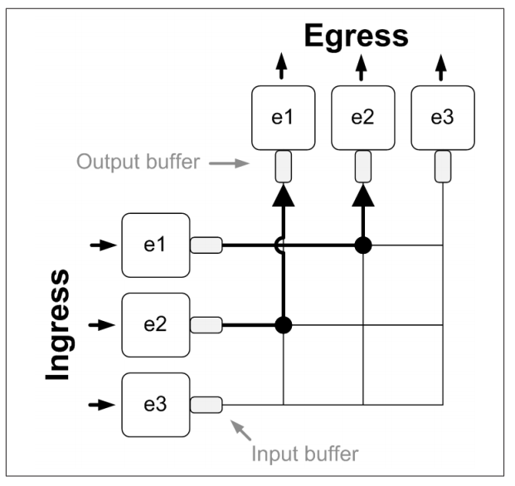

Slide 22
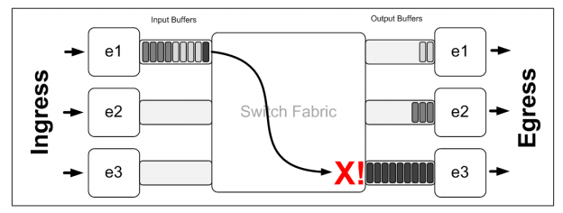

Slide 23
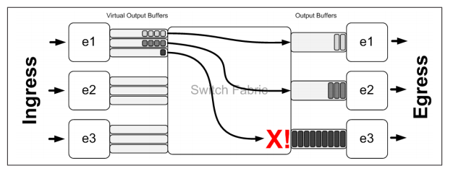

Slide 24
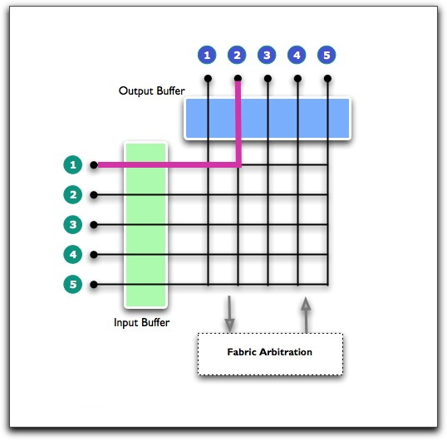

Slide 25
PP – Topologies
Mesh
Linear Array (1-D array) (Pm, Pm+1)
2-D Array
N = number of processor nodes
P(m,n)
P(m+1,n)
P(m-1,n)
P(m,n+1)
P(m,n-1)

Slide 26
Perfect Shuffle Interconnection Network
N=4
N=power of 2
P0,P1,P2,P3 (one way link)
Pm to Pn
Where
j=2i i= (0 ,N/2-1) (0,1)
j=2i + 1 – N i = (N/2,N-1) (2,3)
K=2
After K operation it will be at its own location

Slide 27
